Slide 1
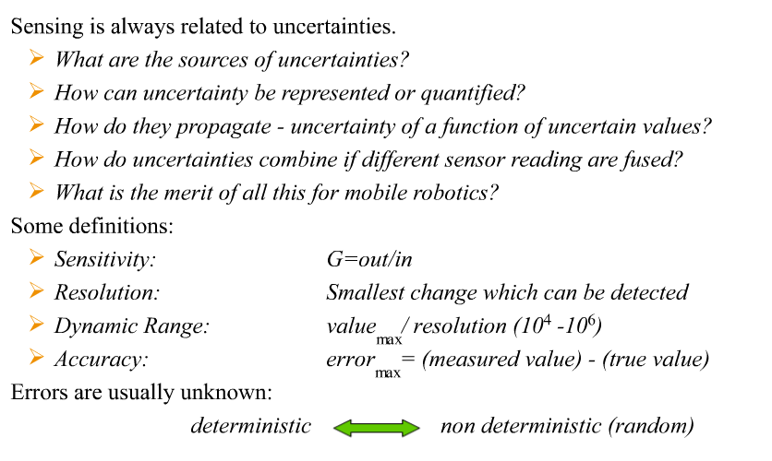
Uncertainty Representation

Slide 2
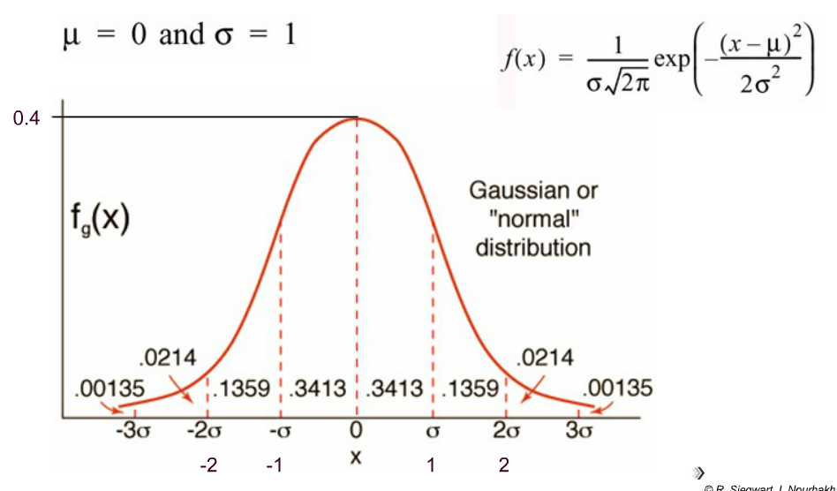
Gaussian Distribution
variance
Standard deviation

Slide 3
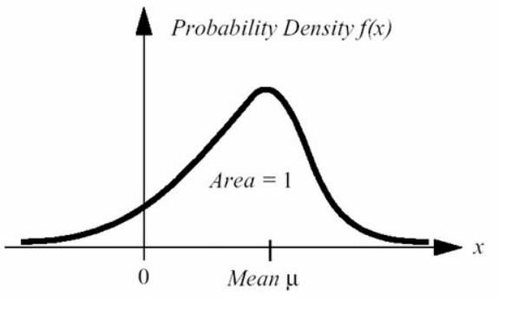
Statistical representation and independence of random variables
problems
Probability density can be not Gaussian
Variables can be dependent

Slide 4
The Error Propagation Law

Slide 5
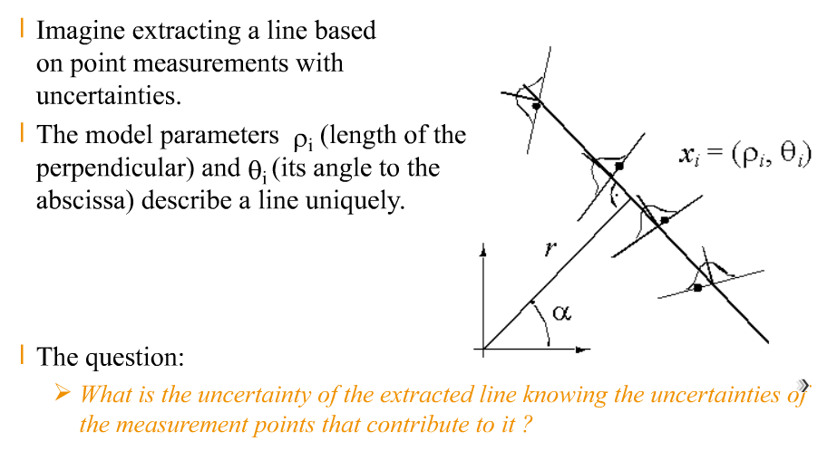
The Error Propagation Law: Motivation
We know uncertain points
We want to extract line
What is the line uncertainty of the line

Slide 6
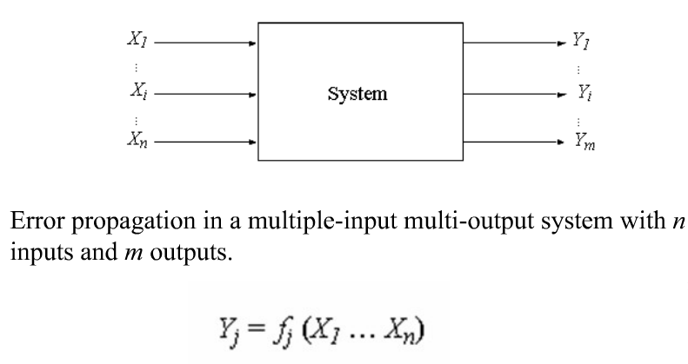
The Error Propagation Law
The system can be linear or not linear
The noise can be Gaussian or not Gaussian

Slide 7
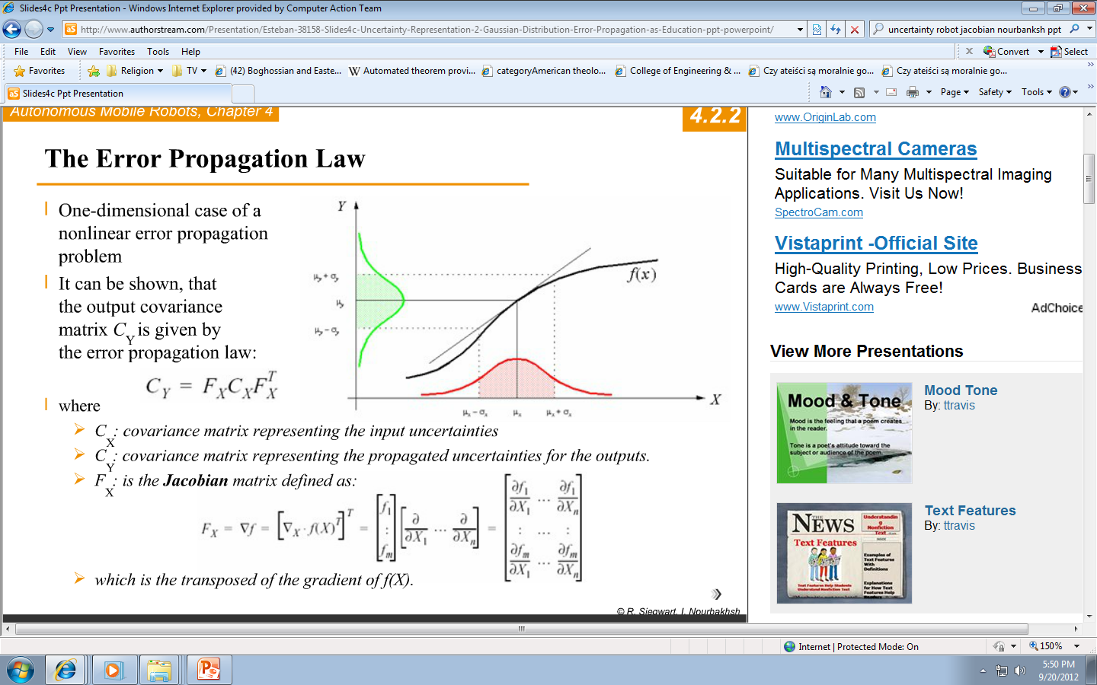
The Error Propagation Law

Slide 8
The Error Propagation Law is fundamental
C_{Y} = F_{X} C_{X} F^{T}_{X}
The Error Propagation Law
Where:
Jacobian is multi-dimensional derivative

Slide 9
Feature Extraction for Scene Interpretation

Slide 10
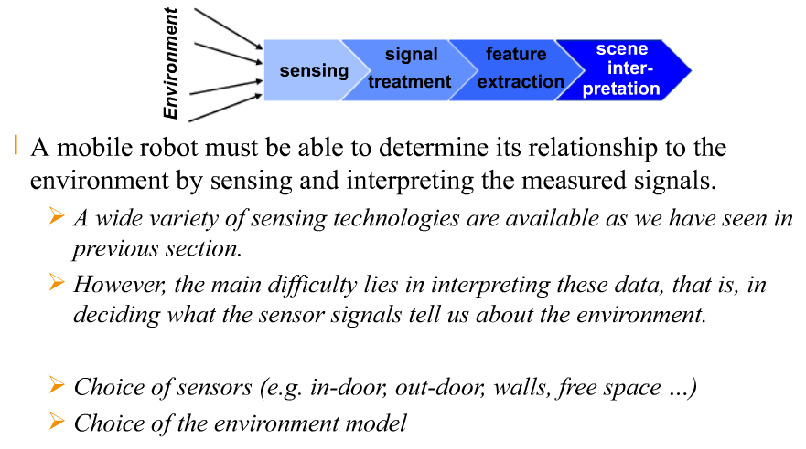
Feature Extraction – Scene Interpretation

Slide 11
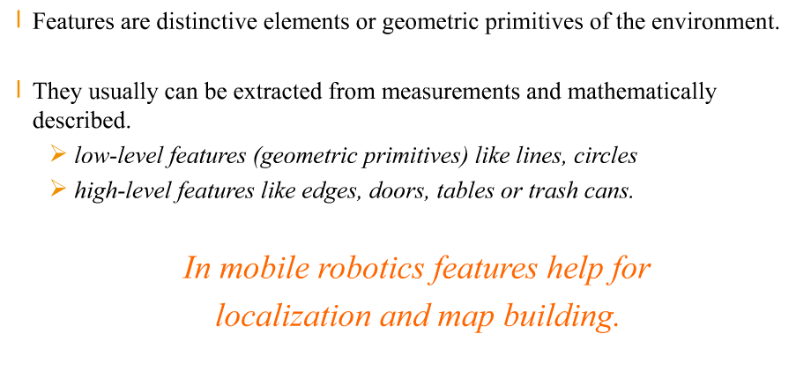
Features

Slide 12
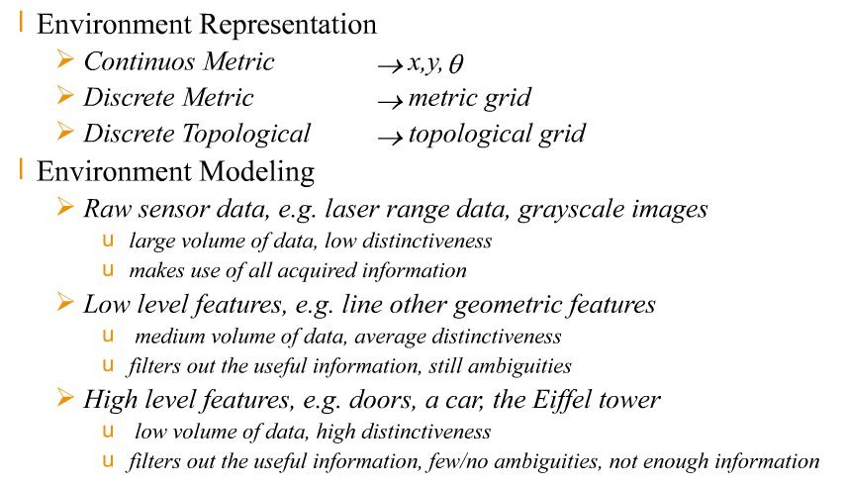
Environment Representation and Modeling → what are the Features?

Slide 13
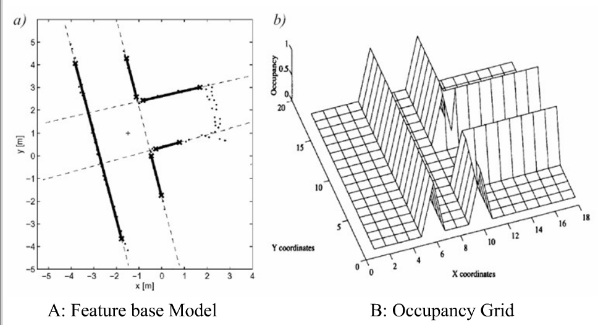
Environmental Models: Examples

Slide 14
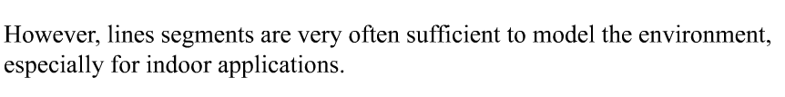
Feature Extraction based on Range Images
Geometric primitives like line segments, circles, corners, edges.
For most other geometric primitives the parametric description of the features becomes too complex
No closed form solutions exist
Line segments are very practical and important
We want to extract a line from a set of points

Slide 15
Feature Extraction for single Sonar or Laser Range Finder

Slide 16
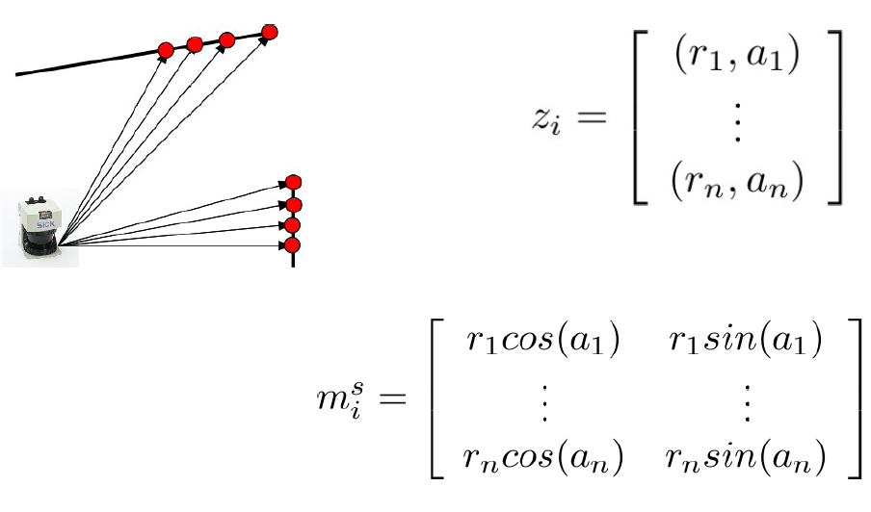
Laser Measurement
Laser measurement is a series of pairs of distance and angle
angle
distance
r
α
x/r = cosα

Slide 17
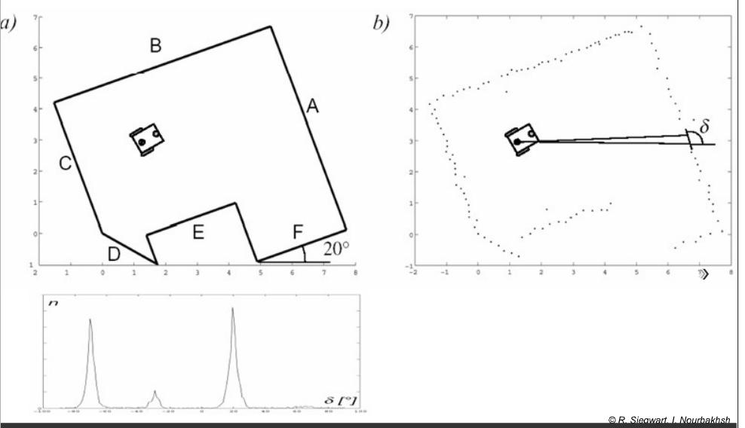
Angular Histogram (range)
Set of points in distance n for angle delta
robot
Our wheelchair robot used this method, one sonar rotating, on top of the robot

Slide 18
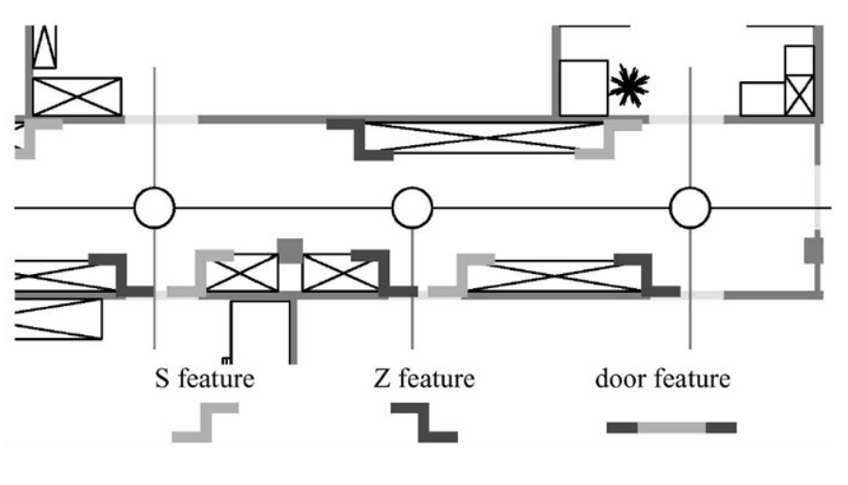
Extracting Other Geometric Features
Based on straight lines, usually vertical
Combinations of lines: S features, Z features, door, window

Slide 19
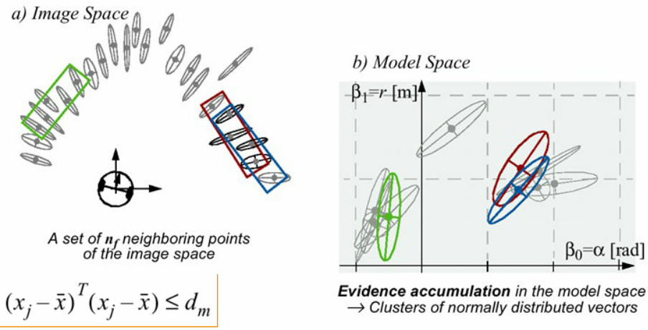
Clustering: Finding neighboring segments of a common line
Segmentation for Line Extraction
Image space versus model space = transformations between them

Slide 20
Feature Extraction

Slide 21
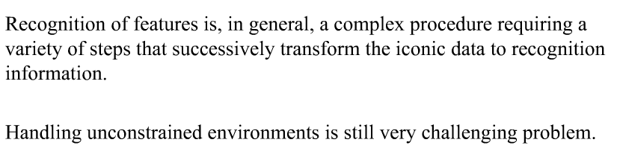
Feature Extraction uses computer vision: Challenges
Methods discussed earlier in robot vision can be used
Sometimes we use simple methods and is enough
Now computers are fast so I recommend to use Canny plus Hough and next processing
Use histograms as well.

Slide 22
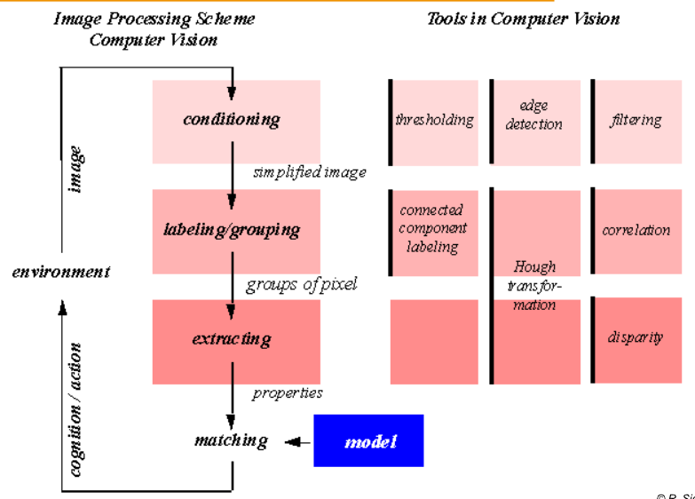
Visual Appearance-Base Feature Extraction (Vision)
Matching and feature extraction can be done on various levels

Slide 23
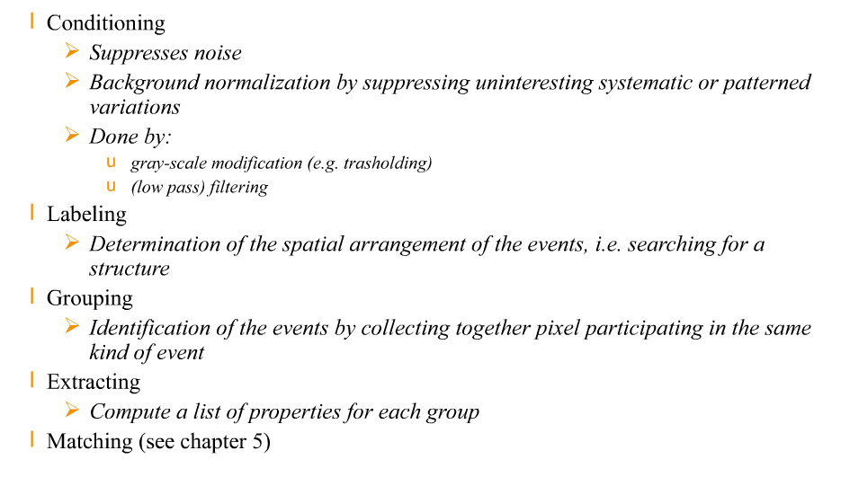
Feature Extraction (Vision): TOOLS
matching

Slide 24
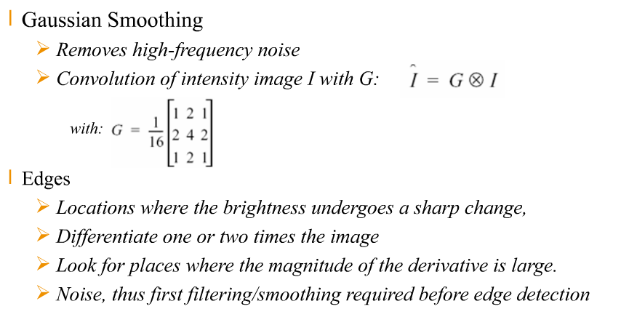
Filtering noise and Edge Detection

Slide 25
Image fingerprint
Image Fingerprint combines many measurements
Image Fingerprint can be done from many sonars, laser range finders, Kinects, etc
Sensor integration = sensor fusion
Can use Kalman or GA for these fusions.

Slide 26
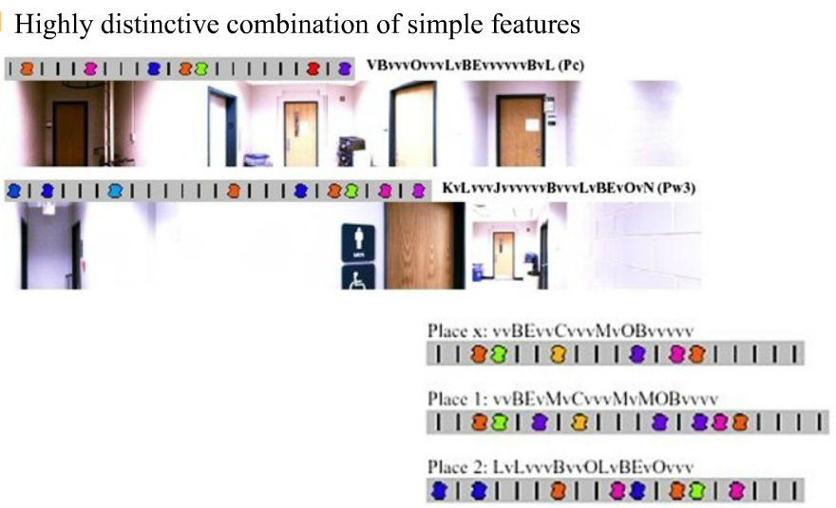
Image Fingerprint Extraction

Slide 27
Example of Probabilistic Line Extraction

Slide 28
Features Based on Range Data:
Line Extraction (1)

Slide 29
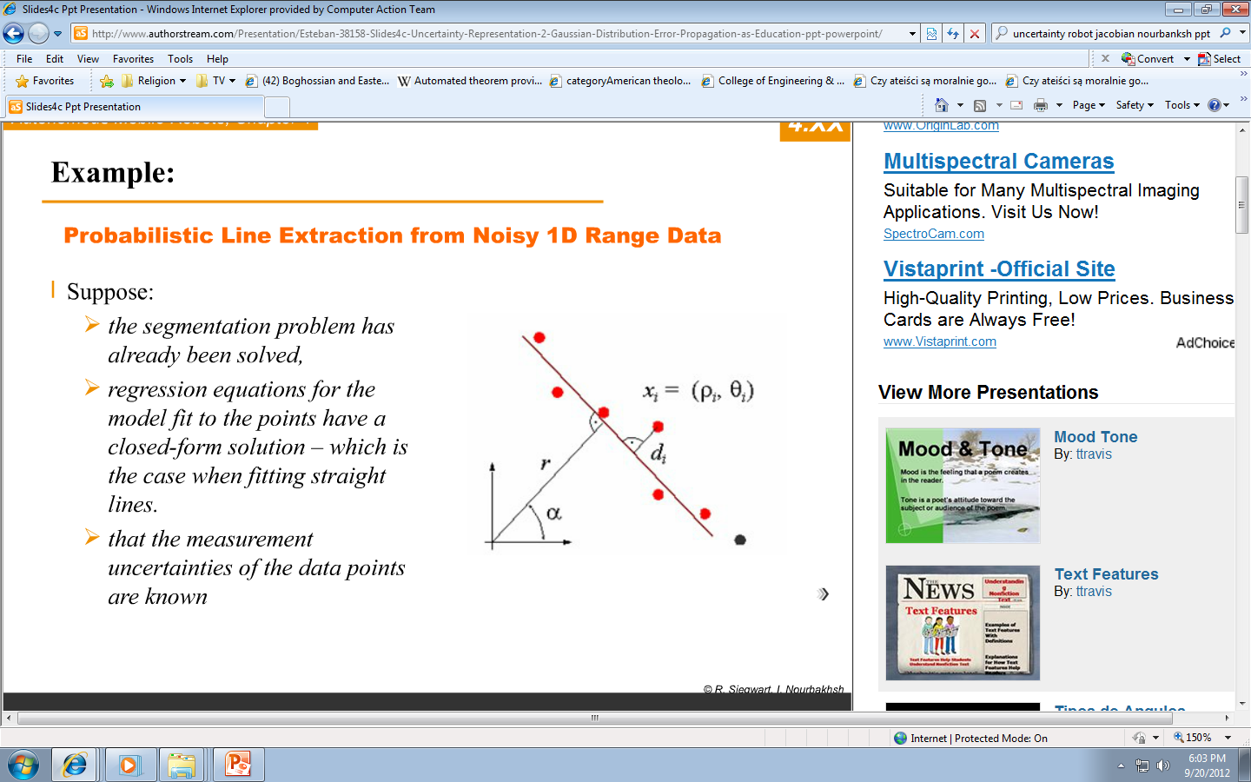
Example
We have a set of points from one side of segmented shape of walls, etc.
We want to fit the straight line to these points.

Slide 30
Example: Problem formulation
We can formulate the Least Square Problem or the Weighted Least Square Problem

Slide 31
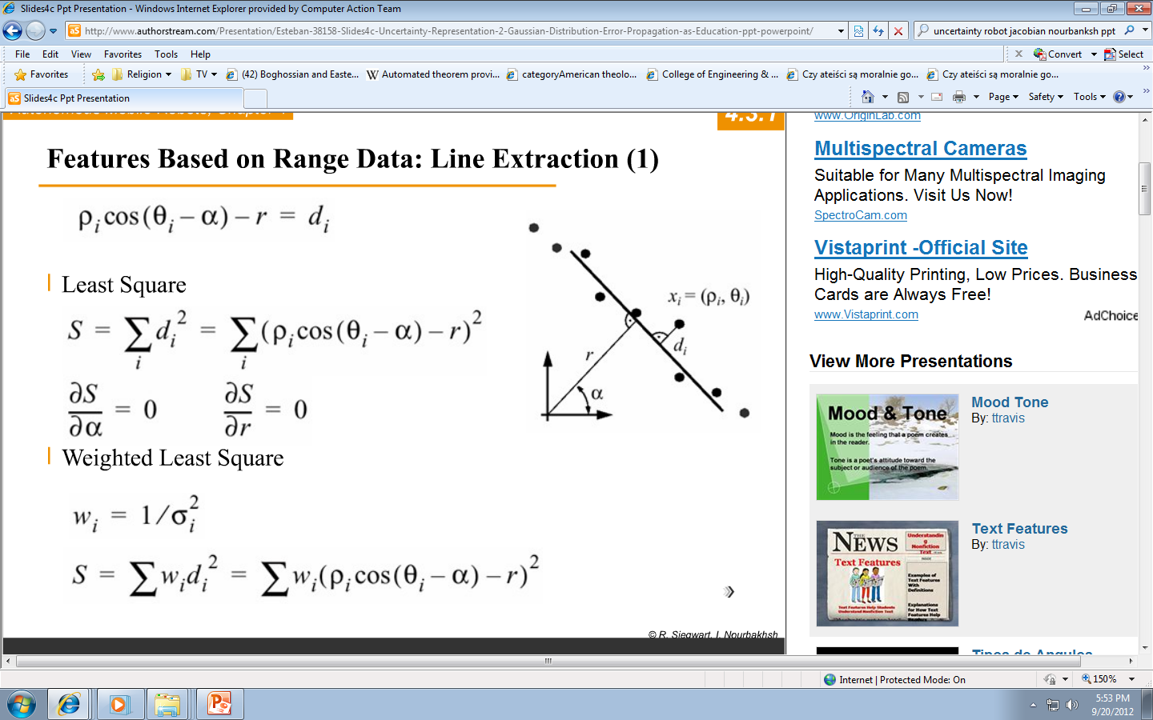
Features Based on Range Data: Line Extraction (1)
From line equation for every point i we get:
We have many points x_{i}
Standard deviation
We will present it soon with more detail

Slide 32
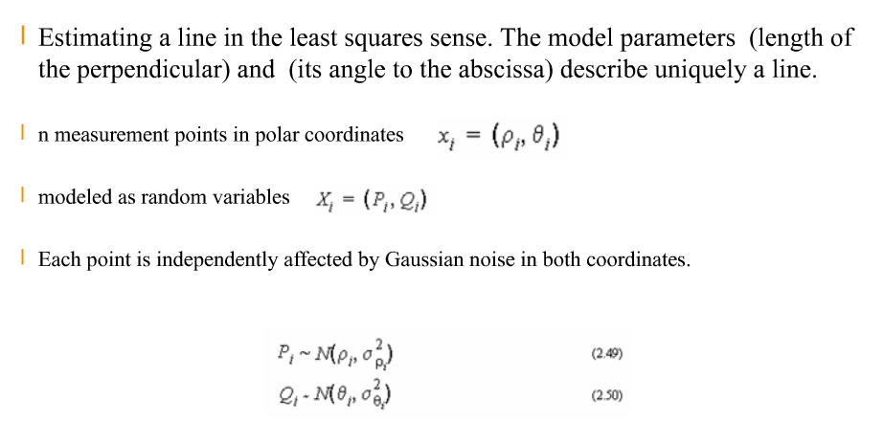
Line Extraction: least squares
Observe that points are modeled as random variables.

Slide 33
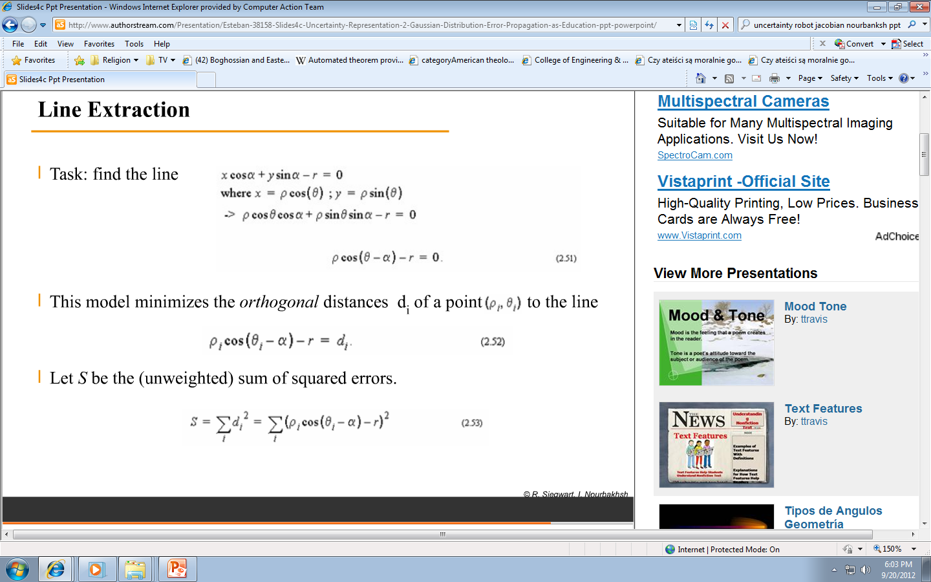
Task
Line Extraction: Task formulation

Slide 34
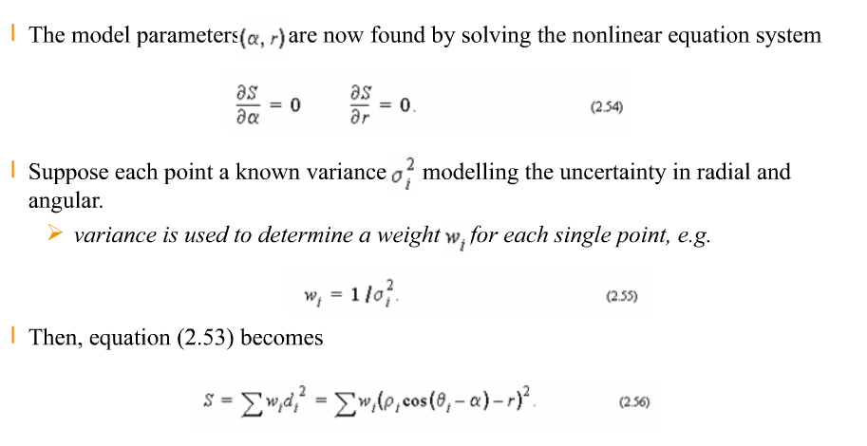
Line Extraction: solving non-linear equation system
We want to find model parameters
We use variance in each point

Slide 35
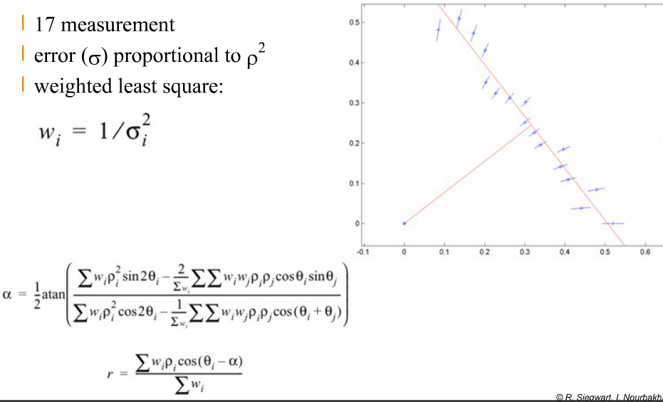
Features Based on Range Data:
Line Extraction Graphical Interpretation
17 measurements
We want to find the best alpha and r for all these points x_{i}

Slide 36
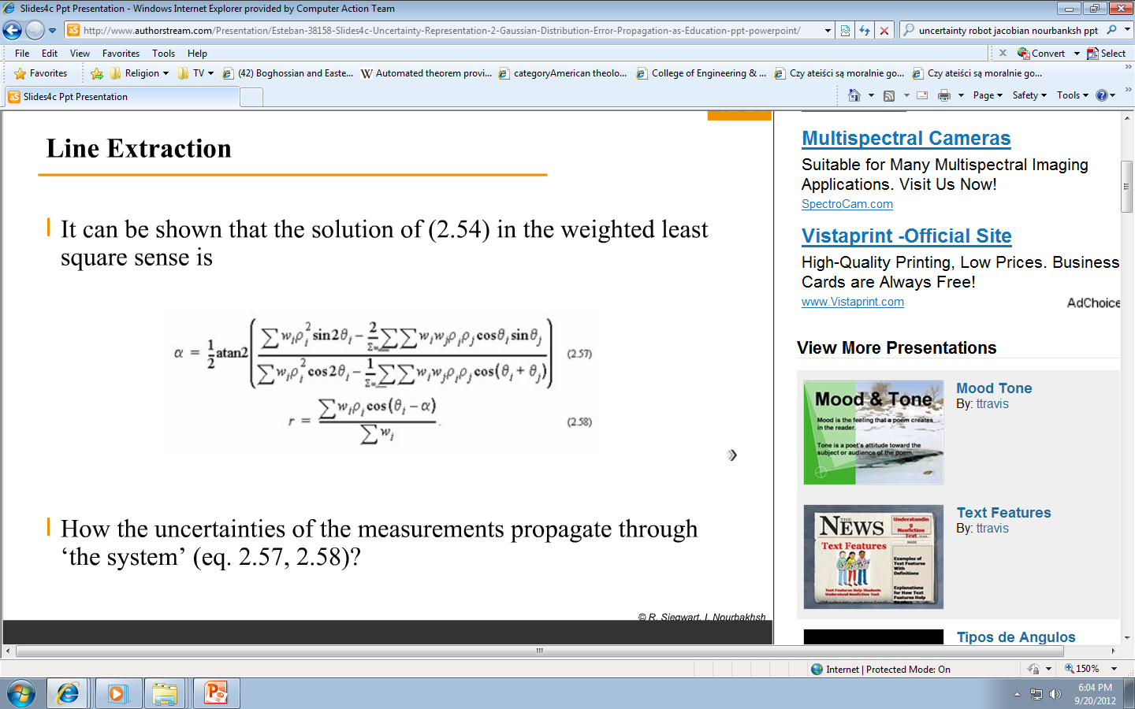
Line Extraction: solution in the weighted least square sense
Coming back to two slides earlier.
It can be shown that the solution of (2.54) in the sense of “weighted least square” is the following:

Slide 37
Propagation through the system

Slide 38
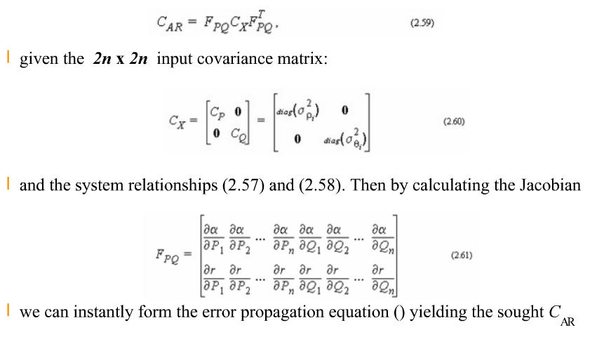
Jacobian
LINE EXTRACTION - The Error Propagation Law

Slide 39
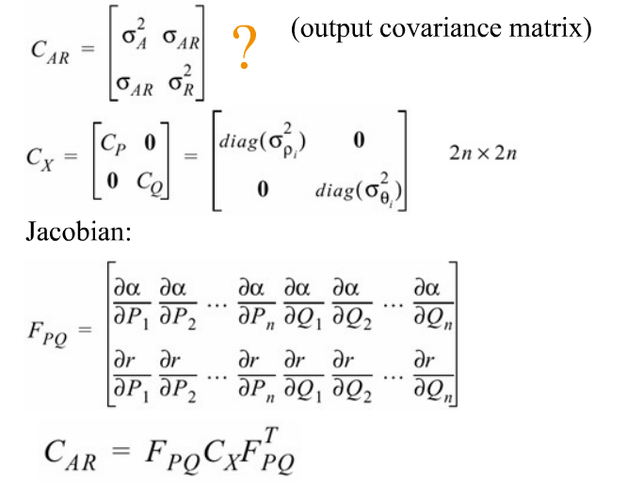
Propagation of Uncertainty during line extraction
We want to calculate the output covariance matrix:

Slide 40
Linear Regression
Feature Extraction can be done using Linear Regression

Slide 41
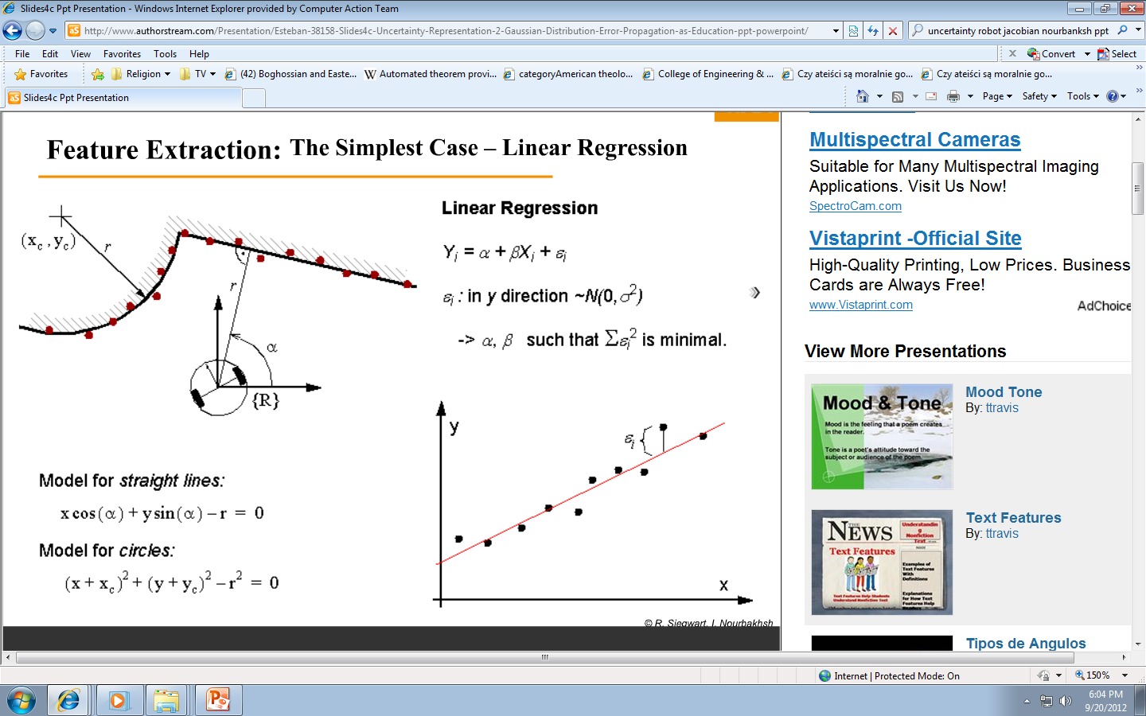
Feature Extraction: The Simplest Case = Linear Regression
Robot measures distances to walls.
Algorithm tries to find the best match using linear regression
Gaussian Error
We try to fit the line to the set of points

Slide 42
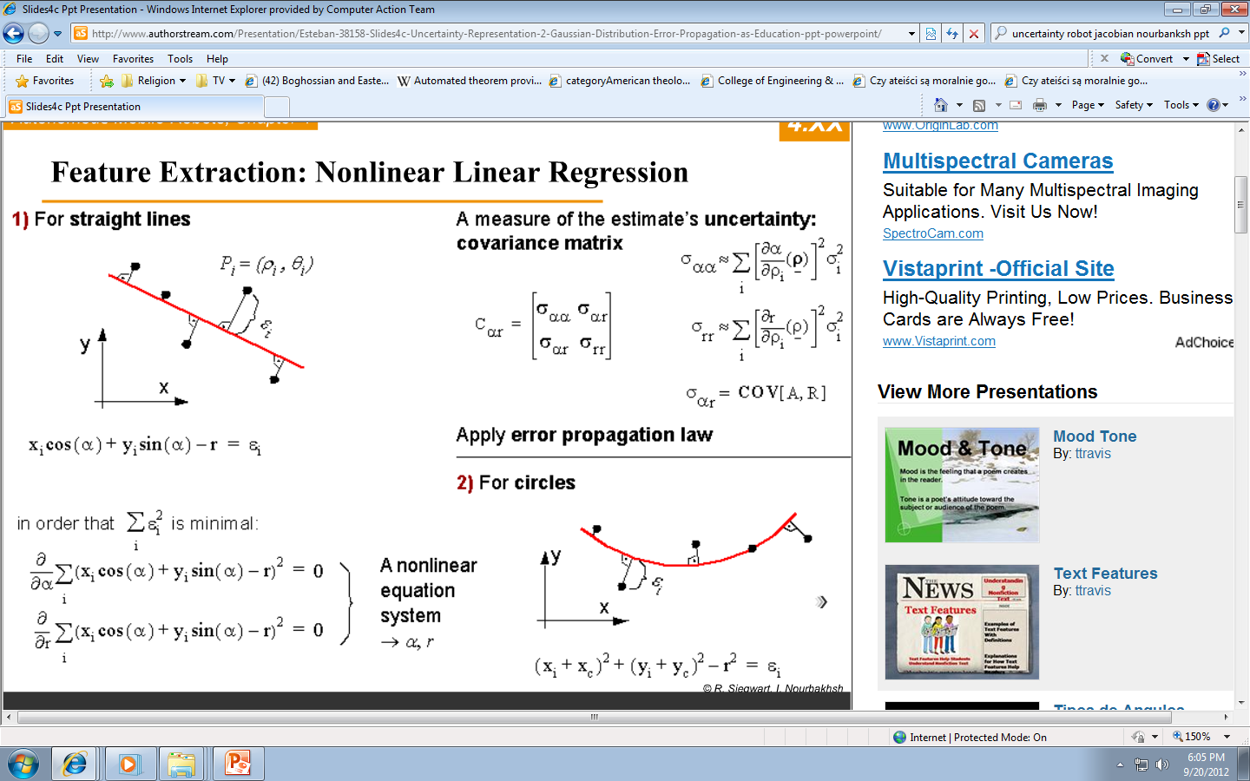
Feature Extraction: Nonlinear Linear Regression
For straight lines
4
1
Set of points (xi, yi)
2
5
We create a non-linear equation system and we solve it for the best values of alpha and r
3

Slide 43
Feature Extraction: Nonlinear Linear Regression
We can do this for any analytic curve but the above is enough in practice

Slide 44
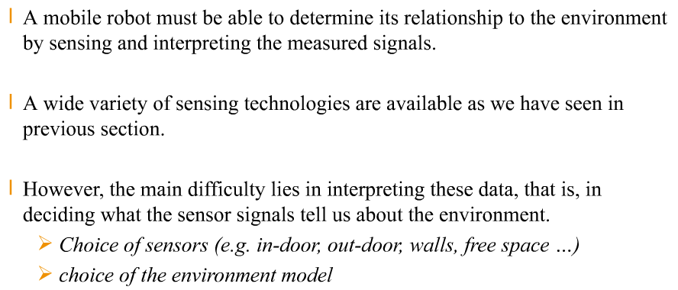
Conclusion on : Feature Extraction and Sensory Interpretation

